Slide 1
Micro, remote, safe settings (safePODS) – extending a safe setting network across a country
Chris Dibben

Slide 2
Background
Administrative Data Research Network (ADRN) is a UK-wide partnership funded by the UK’s Economic and Social Science Research Council.
It aids accredited researchers carry out social and economic research using linked, de-identified, administrative data.
At present there are 6 research centres with safe settings across the UK.

Slide 3
Motivation
Geographical distance will discourage use
Safe setting can be costly to set up, as it involves the building or modification of a room
Overcome barriers - prefabricated micro, safe-rooms - fully controlled and consistent environment for data analysis

Slide 4
What is required?
Needs to be equivalent to conditions in a geographically co-located safe setting.
‘five safes’: safe projects, safe data, safe outputs, safe people and safe environments
in concert, same time, place - data in practise anonymous

Slide 5
Safe people and environments
Production of a ‘regulated space’ - Space in which the data exists, is:
(firstly) only accessible to individuals who are felt to be very unlikely, due to character, professional position and training, to attempt to gain this information
(secondly) allows an ‘unequal gaze’ to exist, where there is the constant possibility of observation

Slide 6
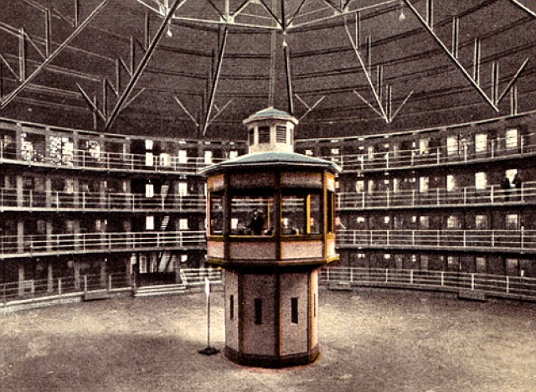
‘unequal gaze’ - Panoptican

Slide 7
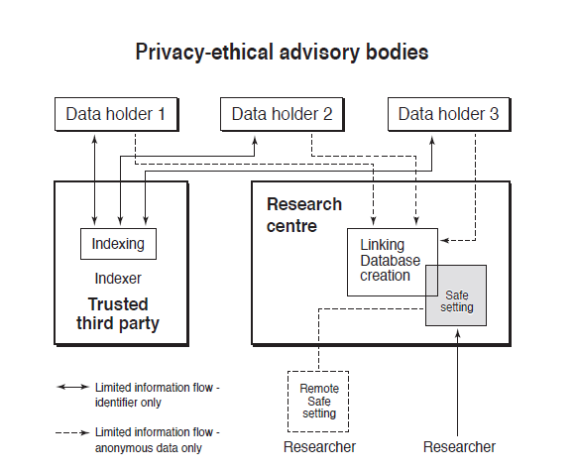
Separation of functions

Slide 8
Safe settings, shaping behaviour and producing regulated spaces
Controlled access (ie it is not in a public space) to the space housing the work space.
Methods for controlling who has access to or is in the work space.
Methods for monitoring behaviour in the workspace – the ‘gaze’ of the research centre.
That the remotely executed work is only visible to those in the work space.
A pleasant working environment that discourages any forbidden behaviour.
Strong environmental ‘cues’ that encourage safe behaviour.
A built structure that needs to resist a deliberate but not a determined malicious intruder (eg an intruder using considerable force or tools).

Slide 9
Major advantages
The safe setting design/ environment would be identical across a network and the safe setting network, as a regulated space, would be more consistent
Could be design to maximise the dual aims of a safe setting: safe and secure but convenient and comfortable research environment.
This would be a scalable and so a more affordable solution for small institutions – larger institutions could simply have multiple units
Could be designed so de- and re-construction was possible and therefore units moved within the country if not used sufficiently or within an institution when restructuring.
Could be reusable as simple workstations/ quiet work places if there use became redundant overtime.
It will not be as space efficient for multiple users ie you could fit more people in an open lab.

Slide 10
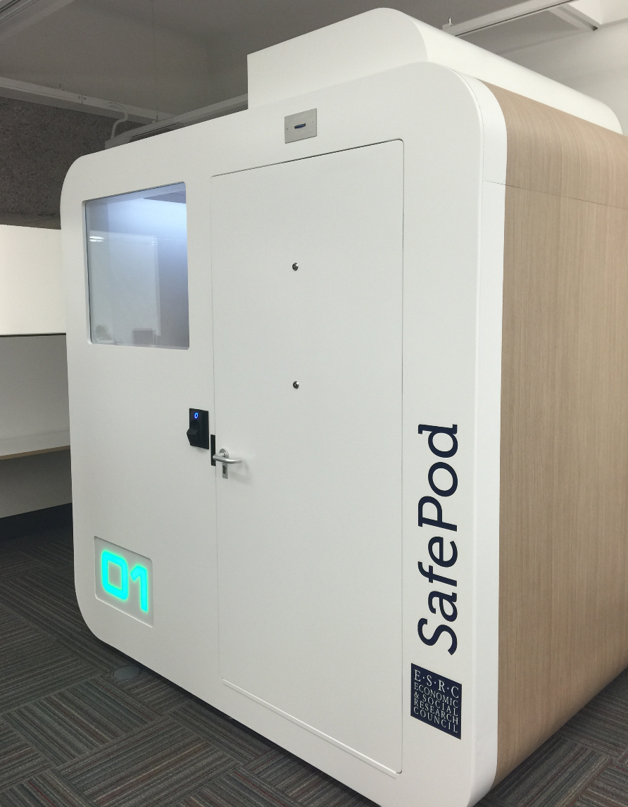

Slide 11
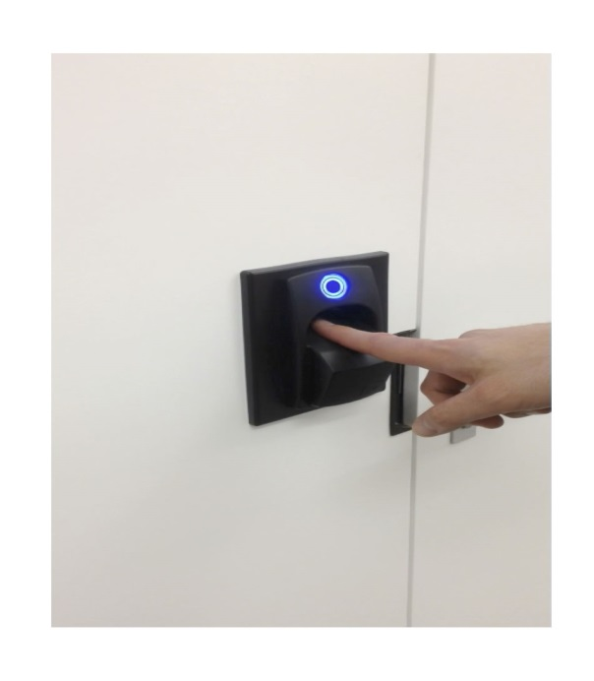
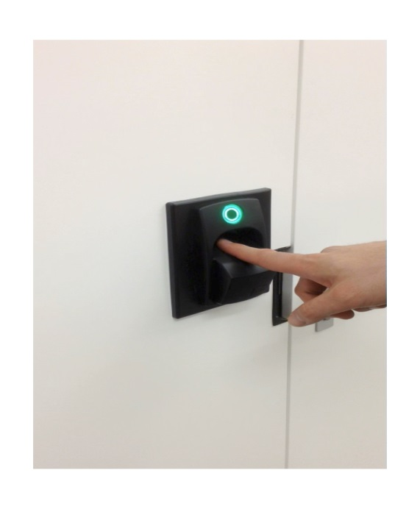
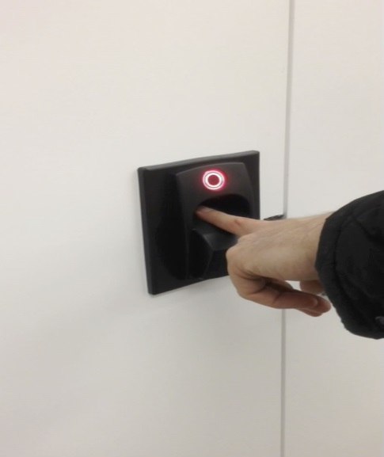
Fingerprint authentication
Blue – reader ready
Green – fingerprint accepted
Red – fingerprint denied
Fingerprints enrolled centrally.
Remote management of access for a person by date and time.

Slide 12
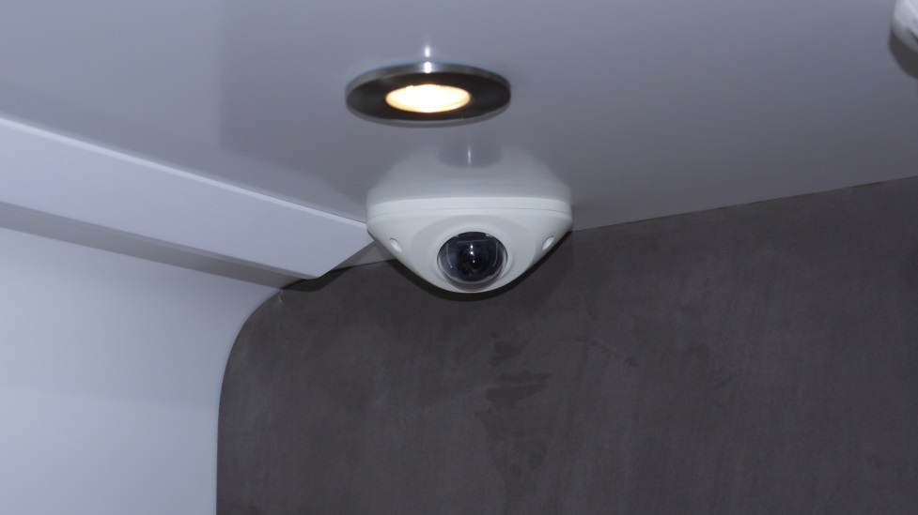
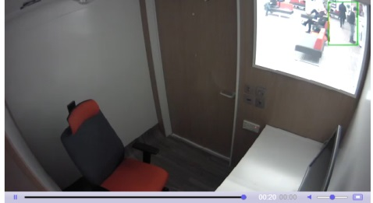
CCTV camera
View from camera
The CCTV camera monitors and records activity remotely. Alerts are sent on motion activation.

Slide 13
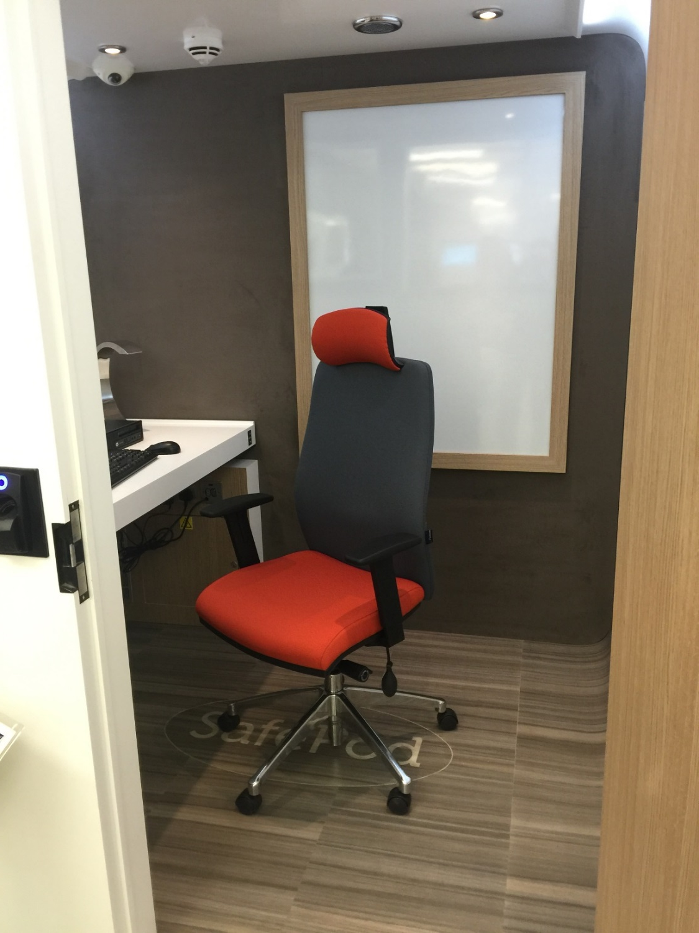

Slide 14
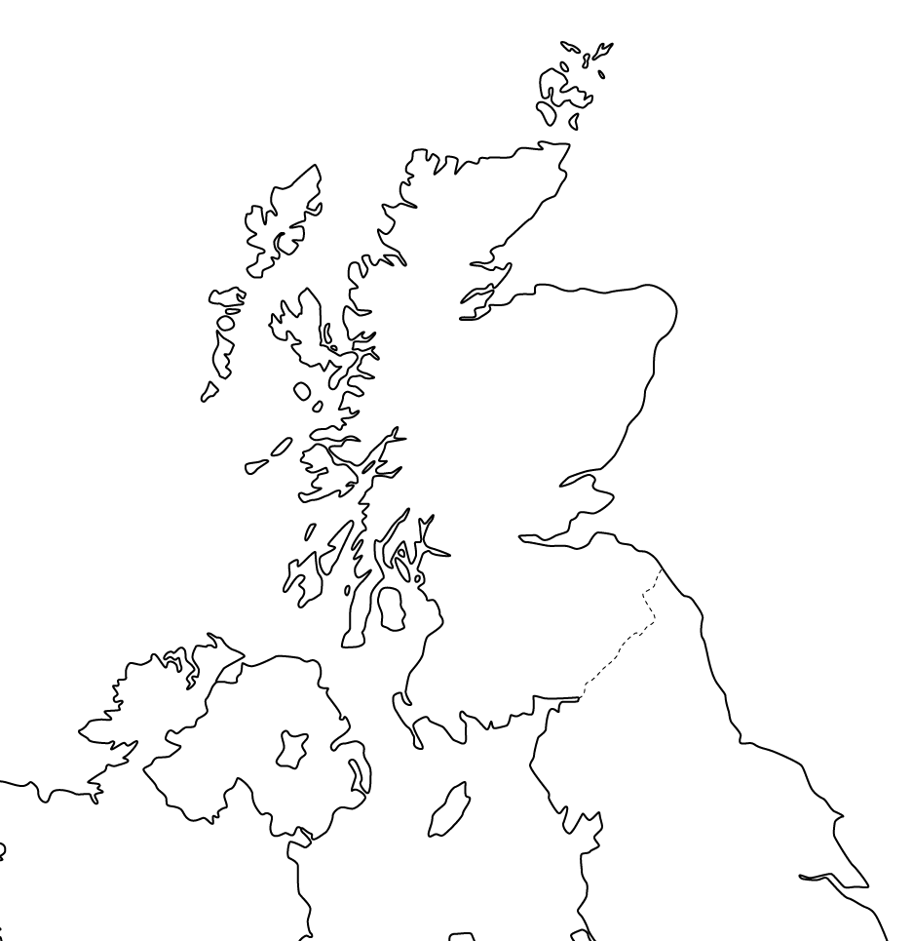
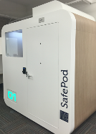
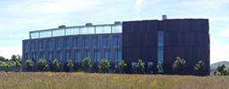
SafePods as Embassies

Slide 15
Conclusions
The safePOD concept therefore represents a flexible tool for extending a safe setting network
Arguably with very little increased risk in the potential of a disclosure of personal data.
It involves relatively little management by the host institution
It may also have particular advantages over traditional ‘safe lab’ type safe settings
it is possible that the safePOD may actually have a greater degree of control and institute a greater level of self-discipline in users than other types of safe setting.

